Slide 1


KRAKEN QGIS PLUGIN • USER MANUAL
Crossfeeder Detection
Automated spatial analysis tool for instant verification of RF feeder swaps using DuckDB Measurement Report (MR) dataset aggregation and directional azimuth alignment.
DuckDB Engine
Spider Tracking
Logical Azimuth
Ultra-fast MR samples query
Real-time sample connection lines
Dynamic direction fallback
Kraken © 2026 | akanipatra@gmail.com

Slide 2
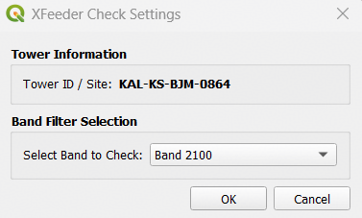
STEP 01 • SELECTION & FILTERING
Tower Identification & Band Configuration
Activate the map tool, select the target site feature, and refine the evaluation by frequency band.
01
Activate Map Tool
Select the Crossfeeder tool icon on the toolbar to switch cursor to pointing hand mode.
02
Select Cell / Site
Click any sector wedge on the map canvas to identify the Tower ID and retrieve site sectors.
03
Filter Target Band
Choose a specific frequency layer (e.g. Band 2100) or check all site bands simultaneously.
Interactive Dialog: Site Identification & Frequency Selection
Kraken © 2026 | akanipatra@gmail.com

Slide 3
STEP 02 • CORE COMPUTATION
Azimuth Matching & Swap Algorithm
How Kraken analyzes Measurement Report sample bearings against target sector direction.
STEP A
STEP B
STEP C
DuckDB MR Query
Bearing Calculation
65% Dominance Check
Queries local DuckDB database using composite key definitions to fetch longitude and latitude coordinates of MR samples.
Computes compass bearing from cell centroid to each MR point, matching samples to the nearest sector's logical azimuth.
Flags sector as CROSSED if over 65% of its MR samples point consistently toward another sector in the same band.
SELECT lon, lat FROM mr_table WHERE cell_id LIKE '%val%'
bearing = atan2(sin(dLon)*cos(lat2), ...)
if dominance > 0.65 -> STATUS: CROSSED
Kraken © 2026 | akanipatra@gmail.com

Slide 4

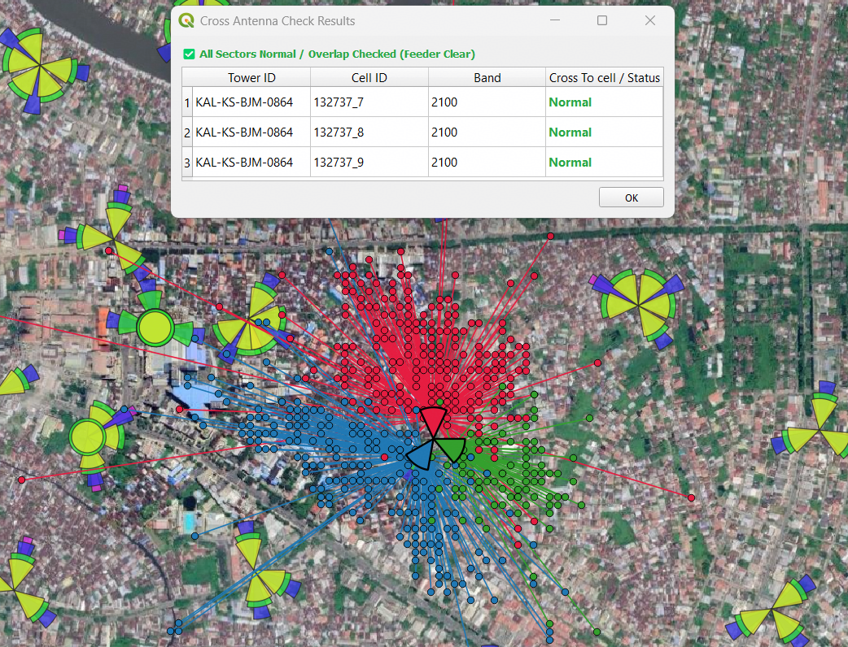
STEP 03 • SPATIAL VISUALIZATION
Spider Line GIS Tracking & Verification
Interactive visual confirmation with dynamic spider lines and sector color mapping.
Categorized Spider Lines
Links cell centroid directly to MR sample locations color-coded by serving sector.
Temporary Layer Clean
Automatically purges old spider layers upon re-running to avoid GIS canvas clutter.
Geodetic Distance Calc
Computes precise WGS84 distance (in meters) for each sample point feature.
Kraken © 2026 | akanipatra@gmail.com

Slide 5
REFERENCE • AUDIT CLASSIFICATION
Result Status Reference Guide
Understanding detection output messages and action guidelines in the pop-up window.
Normal / Clear
STATUS NORMAL
Feeder Swap Detected
STATUS CROSSED
All sectors exhibit aligned MR sample distribution according to designated azimuths. No physical feeder swap detected.
Multiple sectors in the same band show swapped MR sample dominance (>65%). High confidence physical feeder swap.
Action: No field intervention needed.
Action: Dispatch rigger for physical cable swap.
Check Sample MR
STATUS WARNING
No Sample MR
NO SAMPLES
Only 1 sector appears crossed in the band. Likely caused by asymmetrical sample counts, indoor repeaters, or overshooters.
No Measurement Report samples found in DuckDB for the target cell lookup key configuration during the evaluation period.
Action: Verify sample count or check site environment.
Action: Ensure DuckDB file is updated and keys match.
Kraken © 2026 | akanipatra@gmail.com

